Slide 1
Languages and Compilers
(SProg og Oversættere)
Parsing

Slide 2
Parsing
  Describe the purpose of the parser
  Discuss top down vs. bottom up parsing
  Explain necessary conditions for construction of recursive decent parsers
  Discuss the construction of an RD parser from a grammar
  Discuss bottom Up/LR parsing
  Discuss the dangling else problem

Slide 3
Syntax Analysis
Dataflow chart
Source Program
Stream of Characters
Scanner
Error Reports
Stream of “Tokens”
Parser
Error Reports
Abstract Syntax Tree

Slide 4
Top-Down vs Bottom-Up parsing
LL-Analyse (Top-Down)
LR-Analyse (Bottom-Up)
Reduction
Derivation
Look-Ahead
Look-Ahead

Slide 5
Recursive Descent Parsing
Sentence ::= Subject Verb Object .
Subject ::= I | a Noun | the Noun
Object ::= me | a Noun | the Noun
Noun ::= cat | mat | rat
Verb ::= like | is | see | sees
Define a procedure parseN for each non-terminal N
private void parseSentence() ;
private void parseSubject();
private void parseObject();
private void parseNoun();
private void parseVerb();

Slide 6
Recursive Descent Parsing: Parsing Methods
Sentence ::= Subject Verb Object .
private void parseSentence() {
parseSubject();
parseVerb();
parseObject();
accept(‘.’);
}

Slide 7
Recursive Descent Parsing: Parsing Methods
Subject ::= I | a Noun | the Noun
private void parseSubject() {
if (currentTerminal matches ‘I’)
accept(‘I’);
else if (currentTerminal matches ‘a’) {
accept(‘a’);
parseNoun();
}
else if (currentTerminal matches ‘the’) {
accept(‘the’);
parseNoun();
}
else
report a syntax error
}

Slide 8
Formal definition of LL(1)
A grammar G is LL(1) iff
for each set of productions X ::= X₁ | X₂ | … | X_{n} :
starters[X₁], starters[X₂], …, starters[X_{n}] are all pairwise disjoint
If X_{i} =>* ε then starters[X_{j}]∩ follow[X]=Ø, for 1≤j≤ n.i≠j
If G is ε-free then 1 is sufficient
NOTE: starters[X₁] is sometimes called first[X₁]
starters[X] = {t in Terminals | X =>* t β }
Follow[X] = {t in Terminals | S =>+ α X t β }

Slide 9
LL 1 Grammars
parse X*
while (currentToken.kind is in starters[X]) {
parse X
}
Condition: starters[X] must be disjoint from the set of tokens that can immediately follow X *
parse X|Y
switch (currentToken.kind) {
cases in starters[X]:
parse X
break;
cases in starters[Y]:
parse Y
break;
default: report syntax error
}
Condition: starters[X] and starters[Y] must be disjoint sets.

Slide 10
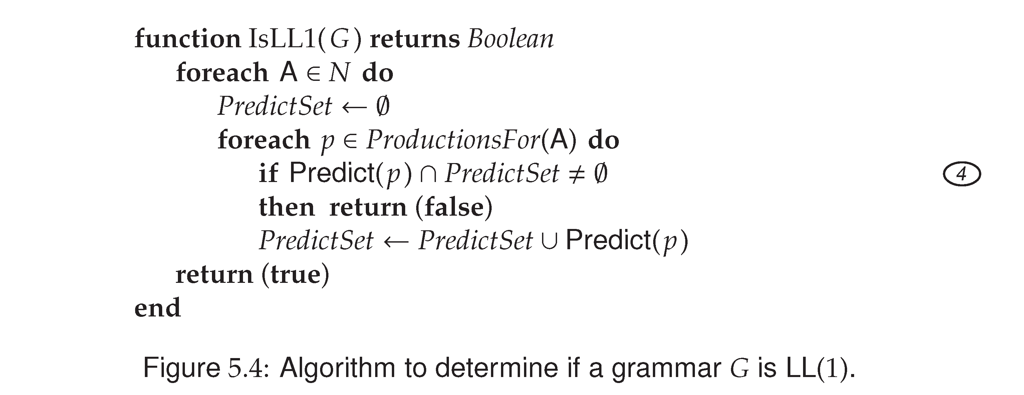
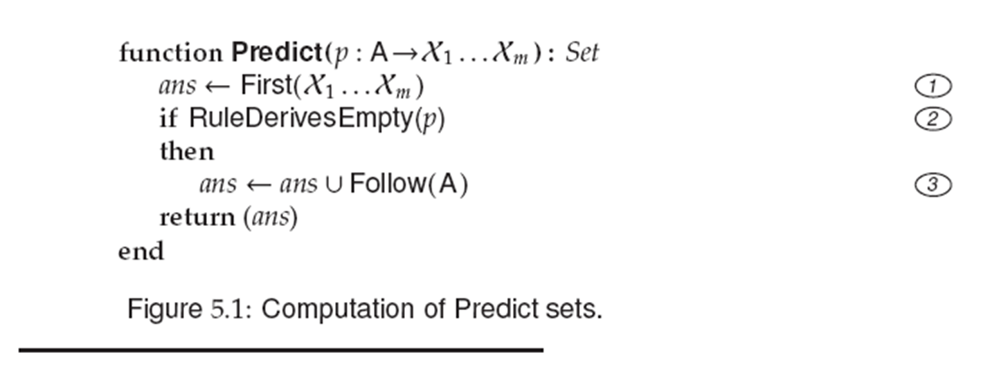

Slide 11
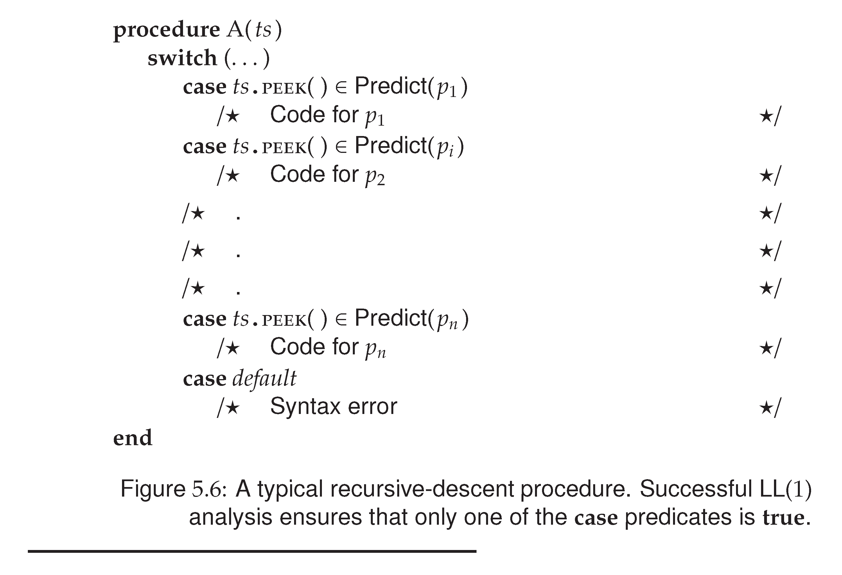

Slide 12
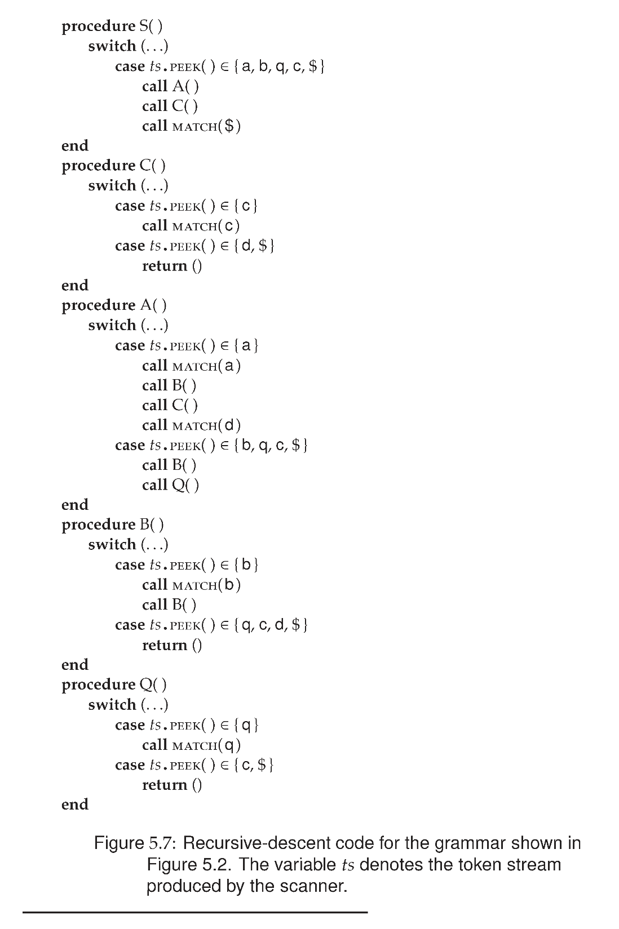
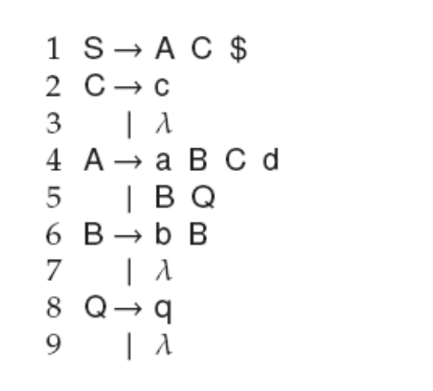
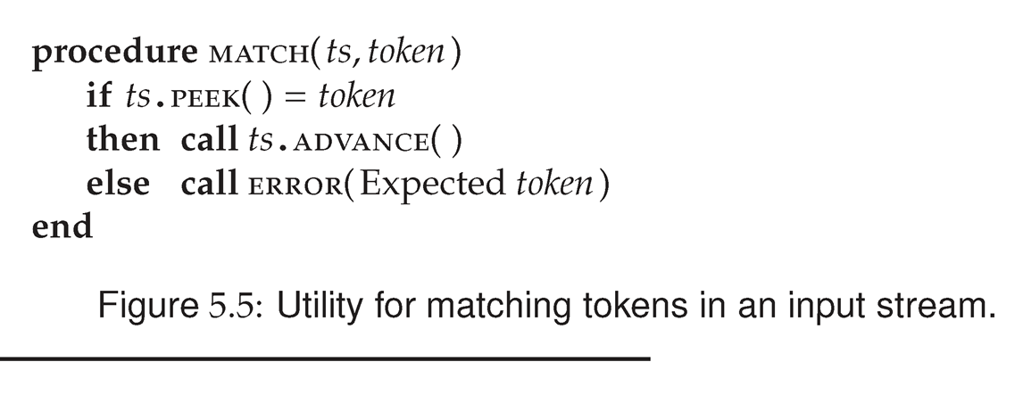

Slide 13
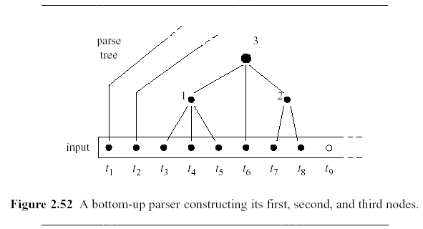
Bottom Up Parsing/ LR Parsing
The main task of a bottom-up parser is to find the leftmost node that has not yet been constructed but all of whose children have been constructed.
The sequence of children is called the handle.
Creating a parent node N and connecting the children in the handle to N is called reducing to N.
(1,6,2) is a handle

Slide 14
Bottom Up Parsers/ shift-reduce
All bottom up parsers have similar algorithm:
  A loop with these parts:
    try to find the leftmost node of the parse tree which has not yet been constructed, but all of whose children have been constructed.
      This sequence of children is called a handle
      Shift is the action of moving the next token to the top of the parse stack
    construct a new parse tree node.
      This is called reducing
The difference between different algorithms is only in the way they find a handle.

Slide 15
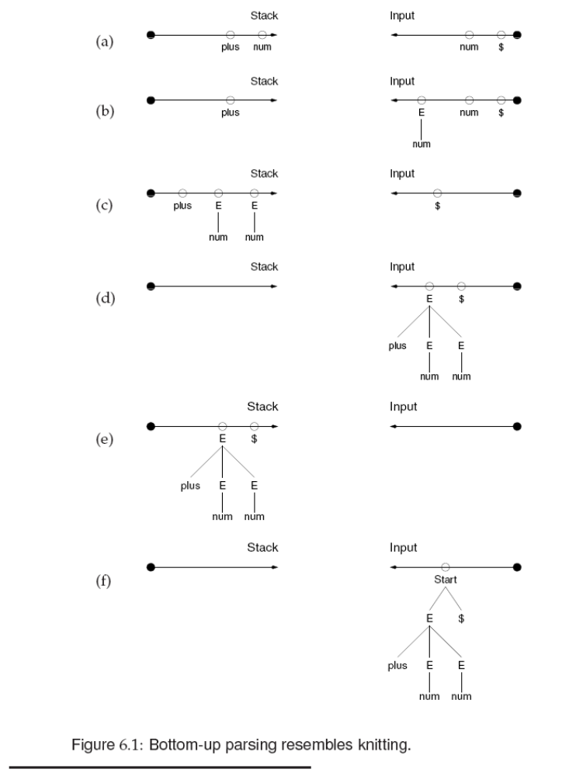
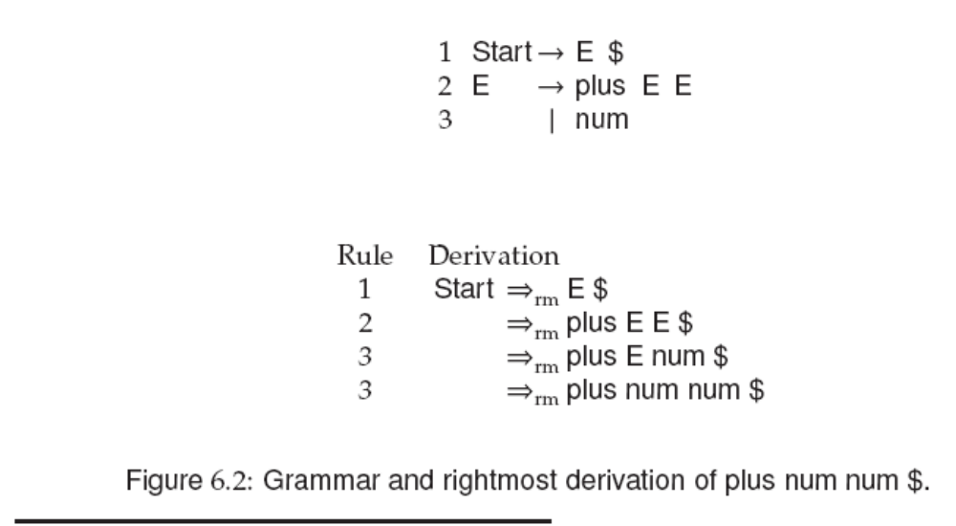

Slide 16
Shifting and reducing
Sentence ::= Subject Verb Object .
Subject ::= I | a Noun | the Noun
Object ::= me | a Noun | the Noun
Noun ::= cat | mat | rat
Verb ::= like | is | see | sees
Shift → ← the cat sees a rat .
Shift the → ← cat sees a rat .
Reduce the cat → ← sees a rat .
Shift the → ← Noun sees a rat .
Reduce the Noun → ← sees a rat .
Reduce → ← Subject sees a rat .
Shift Subject → ← sees a rat .
Reduce Subject sees → ← a rat .
Shift Subject → ← Verb a rat .
Shift Subject Verb → ← a rat .
Shift Subject Verb a → ← rat .
Reduce Subject Verb a rat → ←.
Shift Subject Verb → ← Noun.
Reduce Subject Verb a Noun → ←.
Shift Subject Verb → ← Object.
Shift Subject Verb Object → ←.
Shift Subject Verb Object . → ←
Reduce → ← Sentence
Finish Sentence → ←
Notes:
Ala Fischer

Slide 17
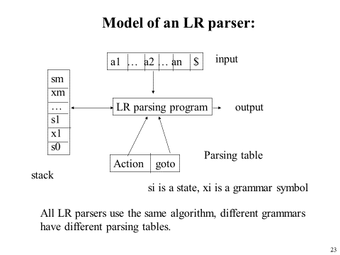
The LR-parse algorithm
A finite automaton
  With transitions and states
A stack
  with objects (symbol, state)
A parse table

Slide 18
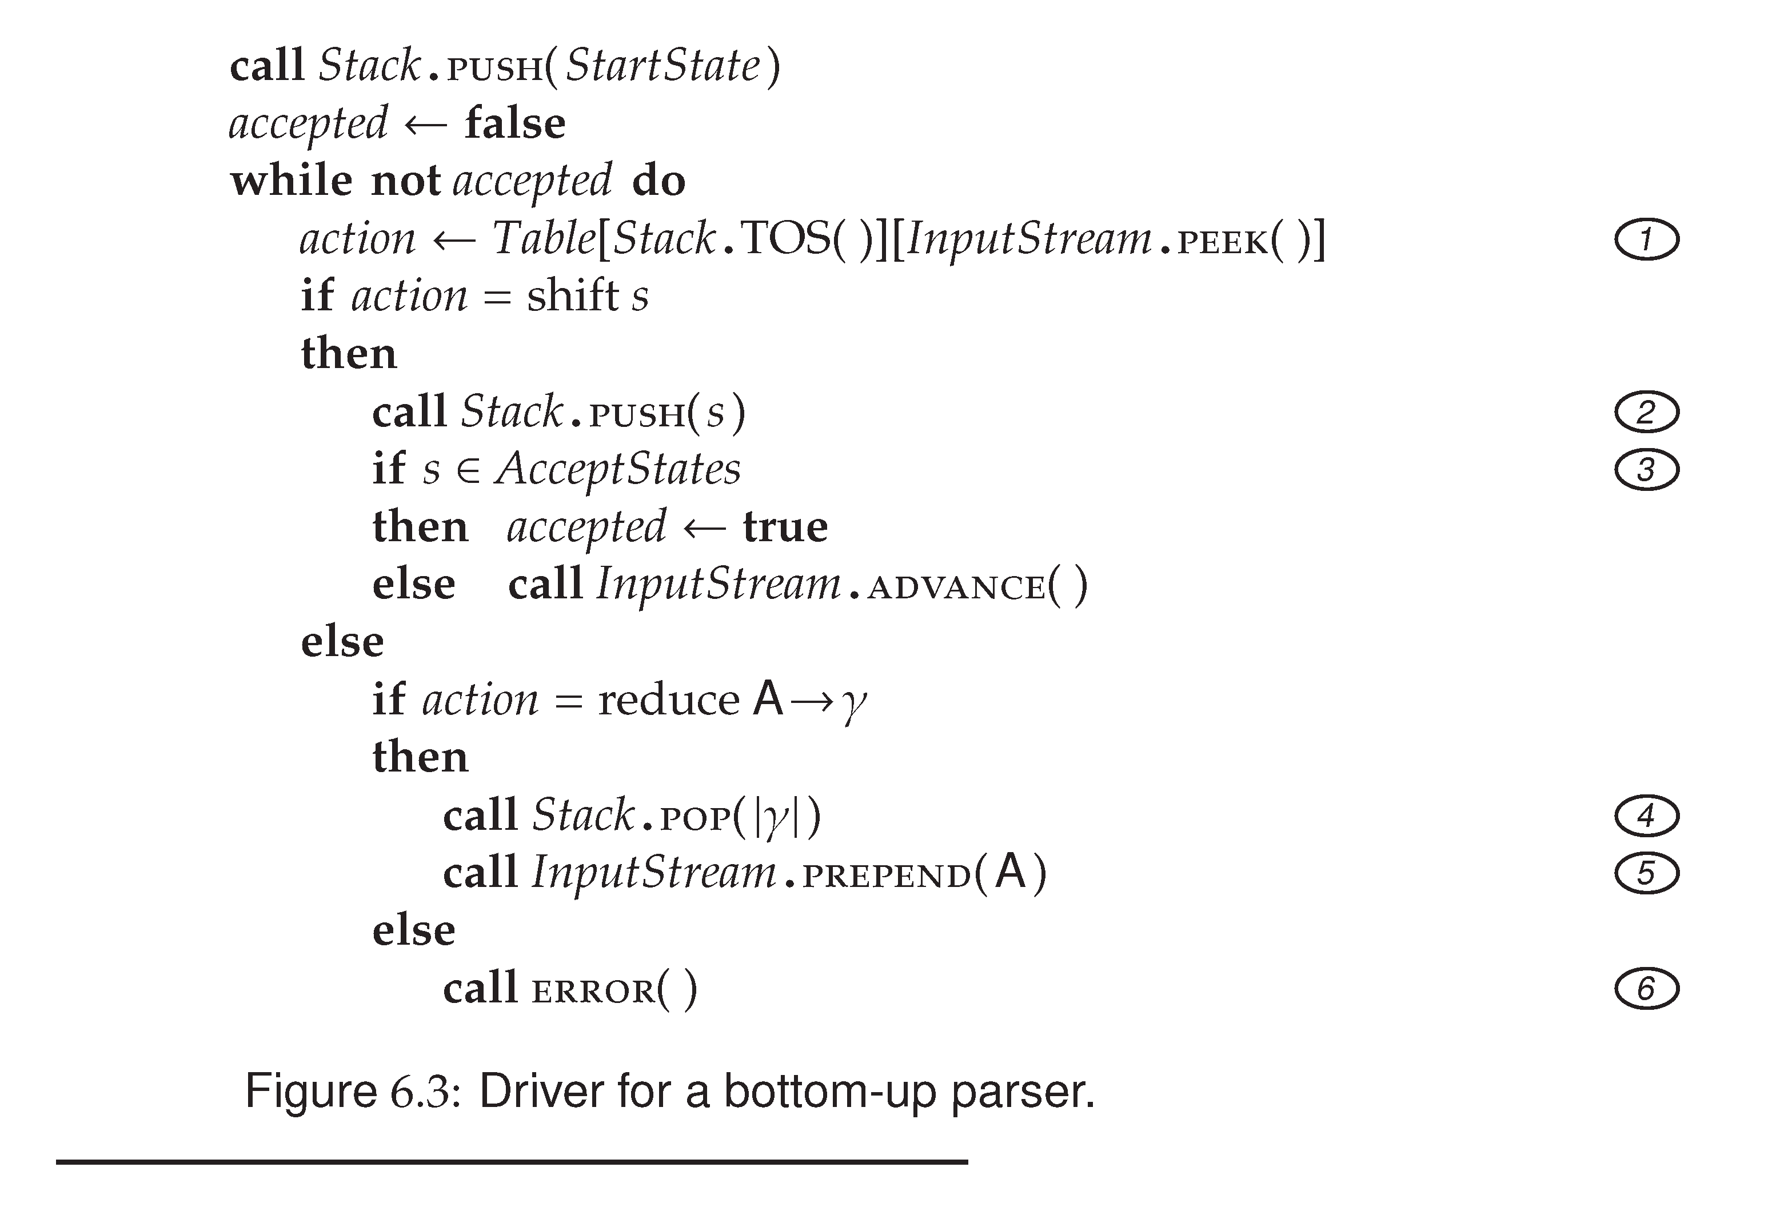
Notes:
Note that PUSH(s) should have been PUSH((InputStream.PEEK(),s))

Slide 19
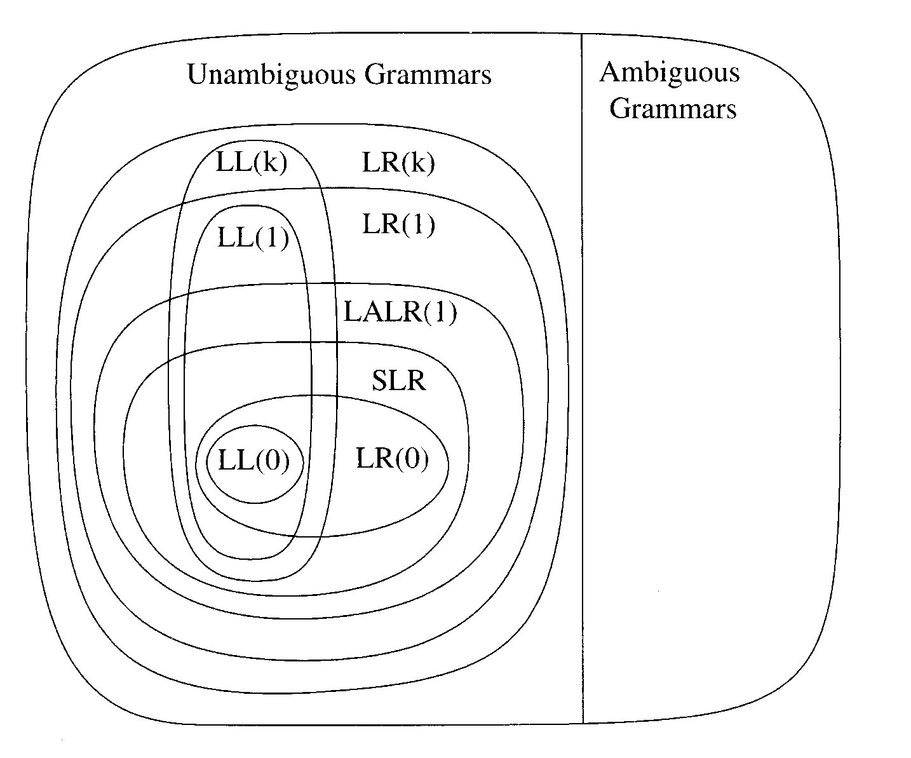
Hierarchy

Slide 20
Dangling Else Problem
Example: (from Mini Triangle grammar)
single-Command
::= if Expression then single-Command
| if Expression then single-Command
else single-Command
This parse tree?
single-Command
single-Command
if a then if b then c1 else c2

Slide 21
Dangling Else Problem
Example: (from Mini Triangle grammar)
single-Command
::= if Expression then single-Command
| if Expression then single-Command
else single-Command
or this one ?
single-Command
single-Command
if a then if b then c1 else c2

Slide 22
Parser Conflict Resolution
Example: “dangling-else” problem (from Mini Triangle grammar)
single-Command
::= if Expression then single-Command
| if Expression then single-Command
else single-Command
LR(1) items (in some state of the parser)
sC ::= if E then sC • {… else …}
sC ::= if E then sC • else sC {…}
Shift-reduce
conflict!
Resolution rule: shift has priority over reduce.
Q: Does this resolution rule solve the conflict? What is its effect on the parse tree?

Slide 23
Dangling Else Problem
Example: “dangling-else” problem (from Mini Triangle grammar)
single-Command
::= if Expression then single-Command
| if Expression then single-Command
else single-Command
Rewrite Grammar:
sC ::= if E then sC endif
| if E then sC else sC endif

